Slide 1
COMP 3500 Introduction to Operating Systems Process Management: Part 1 Process Control Block (PCB)
Dr. Xiao Qin
Auburn University http://www.eng.auburn.edu/~xqin
xqin@auburn.edu
Notes:
12 Minutes Lec02c Project 2 details cont
30 Minutes Slides 1-14
Add more slides here.

Slide 2
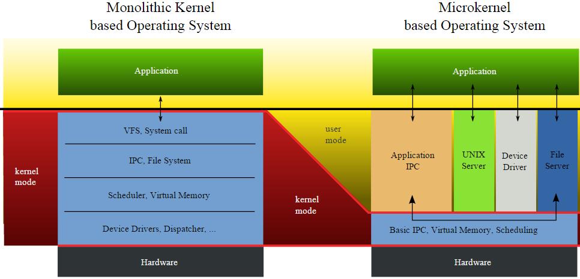
Recap: Monolithic Kernel vs. Microkernel

Slide 3
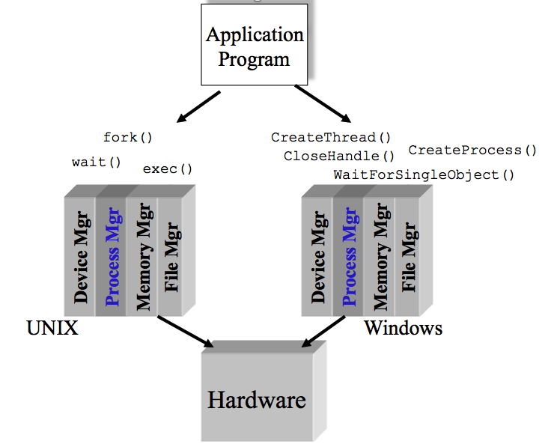
External View of the Process Manager
Q1: What are the three basic components in Microkernel?
Notes:
Three basic components in the microkernel design: process manager, memory manager, IPC – inter-process communication
Now that we have the concepts of applications, system software, and resources,
we are in a position to discuss how the OS can, in an orderly fashion, manage the
execution of applications so that
• Resources are made available to multiple applications.
• The physical processor is switched among multiple applications so all will
appear to be progressing.
• The processor and I/O devices can be used efficiently.
The approach taken by all modern operating systems is to rely on a model in
which the execution of an application corresponds to the existence of one or more
processes.

Slide 4
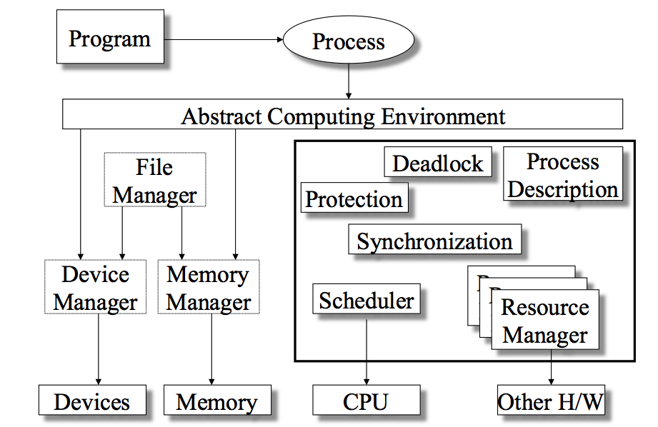
Process Manager Overview
Notes:
Where is the process manager?
The information in the preceding list is stored in a data structure, typically
called a process control block ( Figure 3.1 ), that is created and managed by the OS.
The significant point about the process control block is that it contains sufficient
information so that it is possible to interrupt a running process and later resume
execution as if the interruption had not occurred. The process control block is
the key tool that enables the OS to support multiple processes and to provide for
multiprocessing. When a process is interrupted, the current values of the program
counter and the processor registers (context data) are saved in the appropriate fields
of the corresponding process control block, and the state of the process is changed
to some other value, such as blocked or ready (described subsequently). The OS is
now free to put some other process in the running state. The program counter and
context data for this process are loaded into the processor registers and this process
now begins to execute.
Thus, we can say that a process consists of program code and associated data
plus a process control block. For a single-processor computer, at any given time, at
most one process is executing and that process is in the running state.

Slide 5
OS Management of Application Execution
Q2: What are the purposes (Design Goals) of the process manager?
Resources are made available to multiple applications
The processor is switched among multiple applications so all will appear to be progressing
The processor and I/O devices can be used efficiently
Notes:
What are the purposes or design goals?
Now that we have the concepts of applications, system software, and resources,
we are in a position to discuss how the OS can, in an orderly fashion, manage the
execution of applications so that
• Resources are made available to multiple applications.
• The physical processor is switched among multiple applications so all will
appear to be progressing.
• The processor and I/O devices can be used efficiently.
The approach taken by all modern operating systems is to rely on a model in
which the execution of an application corresponds to the existence of one or more
processes.

Slide 6
What is a process?
An instance of a program in execution.
Notes:
Only four words: a program in execution.
Must use a minimal of five chinese characters to define process.
Now that we have the concepts of applications, system software, and resources,
we are in a position to discuss how the OS can, in an orderly fashion, manage the
execution of applications so that
• Resources are made available to multiple applications.
• The physical processor is switched among multiple applications so all will
appear to be progressing.
• The processor and I/O devices can be used efficiently.
The approach taken by all modern operating systems is to rely on a model in
which the execution of an application corresponds to the existence of one or more
processes.

Slide 7
Process: A Program in Execution
Q3: Which parts does a running program have in a computer system?
Q4: Does a “non-running” program have these parts?
The program code, also called text section
Current activity including program counter, processor registers
Stack containing temporary data
Function parameters, return addresses, local variables
Data section containing global variables
Heap containing memory dynamically allocated during run time
Notes:
An operating system executes a variety of programs:
Batch system – jobs
Time-shared systems – user programs or tasks
Textbook uses the terms job and process almost interchangeably
Process – a program in execution; process execution must progress in sequential fashion
Multiple parts
The program code, also called text section
Current activity including program counter, processor registers
Stack containing temporary data
Function parameters, return addresses, local variables
Data section containing global variables

Slide 8
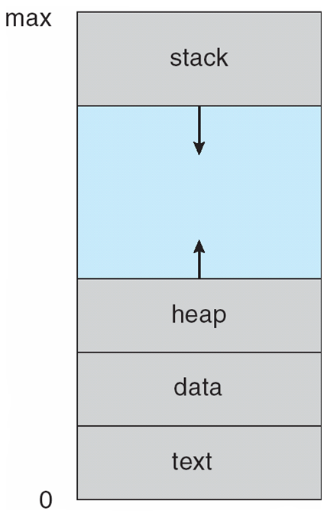
Process: A Program in Execution
Notes:
Draw program counter on the display
Textbook uses the terms job and process almost interchangeably
Process – a program in execution; process execution must progress in sequential fashion
Multiple parts
The program code, also called text section
Current activity including program counter, processor registers
Stack containing temporary data
Function parameters, return addresses, local variables
Data section containing global variables

Slide 9
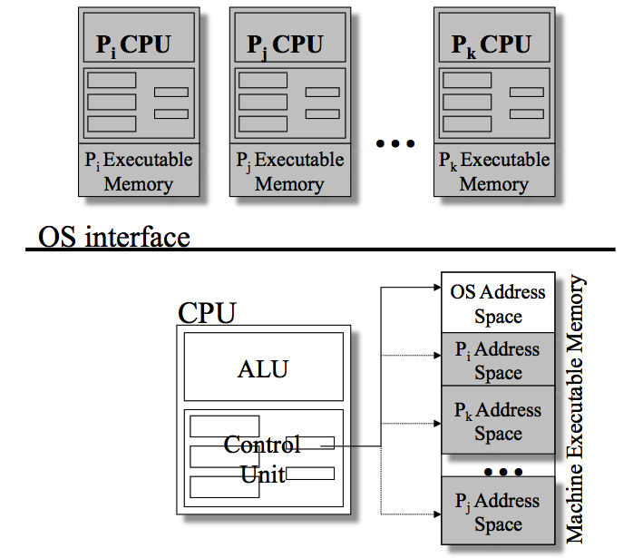
Implementing the Process Abstraction
Notes:
Introduce PCB from here. Please also introduce the concept of address space.
The information in the preceding list is stored in a data structure, typically
called a process control block ( Figure 3.1 ), that is created and managed by the OS.
The significant point about the process control block is that it contains sufficient
information so that it is possible to interrupt a running process and later resume
execution as if the interruption had not occurred. The process control block is
the key tool that enables the OS to support multiple processes and to provide for
multiprocessing. When a process is interrupted, the current values of the program
counter and the processor registers (context data) are saved in the appropriate fields
of the corresponding process control block, and the state of the process is changed
to some other value, such as blocked or ready (described subsequently). The OS is
now free to put some other process in the running state. The program counter and
context data for this process are loaded into the processor registers and this process
now begins to execute.
Now that we have the concepts of applications, system software, and resources,
we are in a position to discuss how the OS can, in an orderly fashion, manage the
execution of applications so that
• Resources are made available to multiple applications.
• The physical processor is switched among multiple applications so all will
appear to be progressing.
• The processor and I/O devices can be used efficiently.
The approach taken by all modern operating systems is to rely on a model in
which the execution of an application corresponds to the existence of one or more
processes.

Slide 10
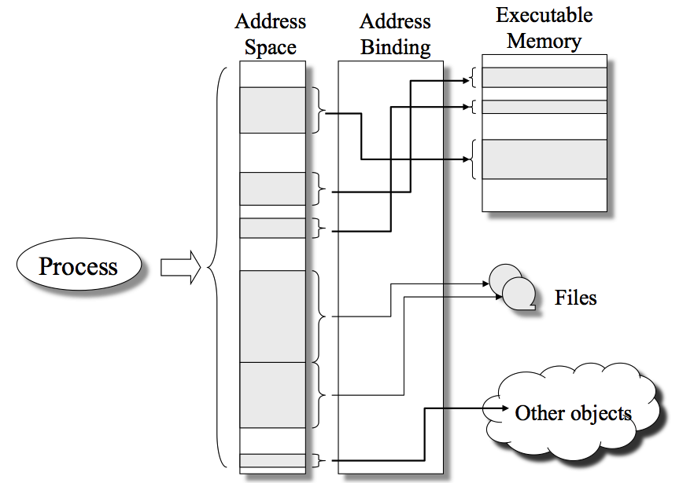
The Address Space
Notes:
The information in the preceding list is stored in a data structure, typically
called a process control block ( Figure 3.1 ), that is created and managed by the OS.
The significant point about the process control block is that it contains sufficient
information so that it is possible to interrupt a running process and later resume
execution as if the interruption had not occurred. The process control block is
the key tool that enables the OS to support multiple processes and to provide for
multiprocessing. When a process is interrupted, the current values of the program
counter and the processor registers (context data) are saved in the appropriate fields
of the corresponding process control block, and the state of the process is changed
to some other value, such as blocked or ready (described subsequently). The OS is
now free to put some other process in the running state. The program counter and
context data for this process are loaded into the processor registers and this process
now begins to execute.
Thus, we can say that a process consists of program code and associated data
plus a process control block. For a single-processor computer, at any given time, at
most one process is executing and that process is in the running state.

Slide 11
Recap: Process Elements
Program code
A set of data associated with that code
Notes:
Recall from Chapter 2 that we suggested several definitions of the term process ,
including
• A program in execution
• An instance of a program running on a computer
• The entity that can be assigned to and executed on a processor
• A unit of activity characterized by the execution of a sequence of instructions,
a current state, and an associated set of system resources
We can also think of a process as an entity that consists of a number of elements.
Two essential elements of a process are program code (which may be shared with
other processes that are executing the same program) and a set of data associated
with that code. Let us suppose that the processor begins to execute this program
code, and we refer to this executing entity as a process.

Slide 12
Process Elements
Q5: While the program is executing, what elements can uniquely characterize its process?
identifier
state
priority
program counter
memory pointers
context data
I/O status information
accounting information
Notes:
At any given point in time,
while the program is executing , this process can be uniquely characterized by a
number of elements, including the following:
• Identifier: A unique identifier associated with this process, to distinguish it
from all other processes.
• State: If the process is currently executing, it is in the running state.
• Priority: Priority level relative to other processes.
• Program counter: The address of the next instruction in the program to be
executed.
• Memory pointers: Includes pointers to the program code and data associated
with this process, plus any memory blocks shared with other processes.
• Context data: These are data that are present in registers in the processor
while the process is executing.
• I/O status information: Includes outstanding I/O requests, I/O devices (e.g.,
disk drives) assigned to this process, a list of files in use by the process, and
so on.
• Accounting information: May include the amount of processor time and clock
time used, time limits, account numbers, and so on.

Slide 13
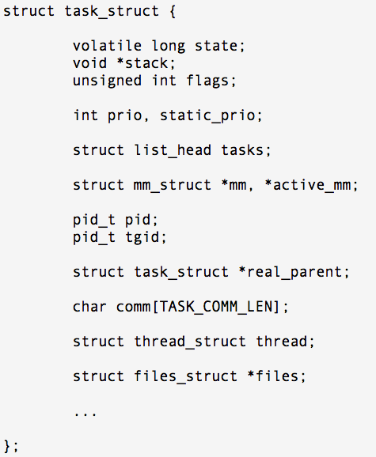
Process Control Block
Contains the process elements
It is possible to interrupt a running process and later resume execution as if the interruption had not occurred
Created and managed by the operating system
Key tool that allows support for multiple processes
Q6: Can you design a data structure for PCB?
Notes:
The information in the preceding list is stored in a data structure, typically
called a process control block ( Figure 3.1 ), that is created and managed by the OS.
The significant point about the process control block is that it contains sufficient
information so that it is possible to interrupt a running process and later resume
execution as if the interruption had not occurred. The process control block is
the key tool that enables the OS to support multiple processes and to provide for
multiprocessing. When a process is interrupted, the current values of the program
counter and the processor registers (context data) are saved in the appropriate fields
of the corresponding process control block, and the state of the process is changed
to some other value, such as blocked or ready (described subsequently). The OS is
now free to put some other process in the running state. The program counter and
context data for this process are loaded into the processor registers and this process
now begins to execute.
Thus, we can say that a process consists of program code and associated data
plus a process control block. For a single-processor computer, at any given time, at
most one process is executing and that process is in the running state.

Slide 14
Summary
What is a process?
Background
Processes and process control blocks
Process description
Operating system control structures
Process control structures
Notes:
Chapter 3 Summary

